Slide 1
Kafka Fundamental
Tran Minh - NashtechGlobal
06-2022

Slide 2
Introduction To Kafka
Tour of Kafka
Apache Kafka QuickStart
NodeJS & Kafka

Slide 3
01
Introduction To Kafka

Slide 4
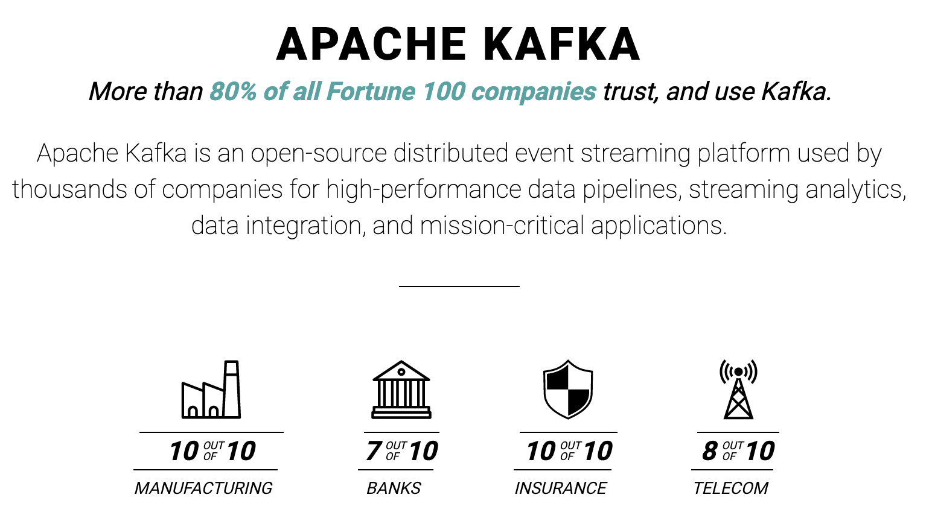

Slide 5
What is event streaming?
The digital equivalent of the human body's central nervous system.
It is the technological foundation for the 'always-on' world where businesses are increasingly software-defined and automated, and where the user of software is more software.
Event streaming is the practice of capturing data in real-time from event sources like databases, sensors, mobile devices, cloud services, etc.
Storing these event streams durably for later retrieval
Manipulating, processing, and reacting to the event streams in real-time as well as retrospectively
Routing the event streams to different destination technologies as needed.
Ensures a continuous flow and interpretation of data so that the right information is at the right place, at the right time.

Slide 6
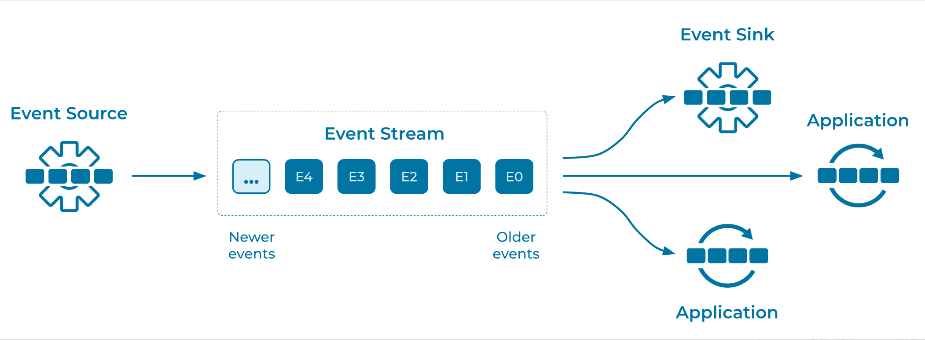

Slide 7
What can I use event streaming for?
To process payments and financial transactions in real-time, such as in stock exchanges, banks, and insurances.
To track and monitor cars, trucks, fleets, and shipments in real-time, such as in logistics and the automotive industry.
To continuously capture and analyze sensor data from IoT devices or other equipment, such as in factories and wind parks.
To collect and immediately react to customer interactions and orders, such as in retail, the hotel and travel industry, and mobile applications.
To monitor patients in hospital care and predict changes in condition to ensure timely treatment in emergencies.
To connect, store, and make available data produced by different divisions of a company.
To serve as the foundation for data platforms, event-driven architectures, and microservices.

Slide 8
What is Kafka?
Apache Kafka is an event streaming platform.
Kafka combines three key capabilities, so you can implement for event streaming end-to-end with a single battle-tested solution.
To publish (write) and subscribe to (read) streams of events, including continuous import/export of your data from other systems.
To store streams of events durably and reliably for as long as you want.
To process streams of events as they occur or retrospectively.
And all this functionality is provided in a distributed, highly scalable, elastic, fault-tolerant, and secure manner.

Slide 9
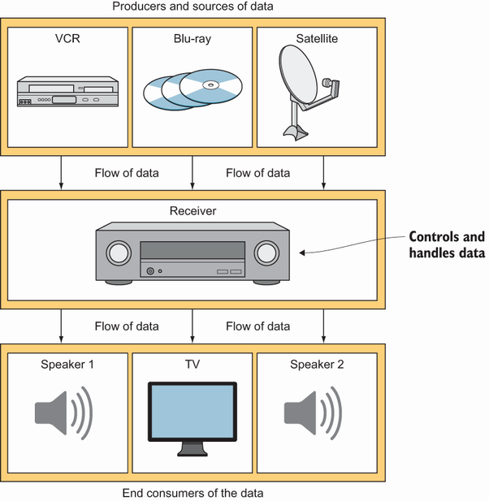
Notes:
As figure 1.1 shows, digital satellite, cable, and Blu-ray™ players can connect to a central receiver. You can think of those individual pieces as regularly sending data in a format that they know about.
That flow of data can be thought of as nearly constant while a movie or CD is playing
The receiver deals with this constant stream of data and converts it into a usable format for the external devices attached to the other end (the receiver sends the video to your television and the audio to a decoder as well as to the speakers).

Slide 10
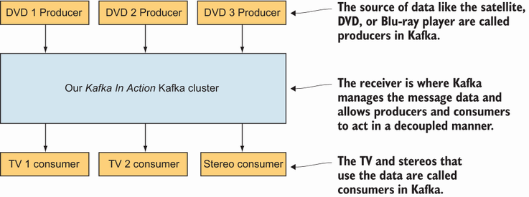
Notes:
Kafka includes clients to interface with other systems.
One such client type is called a producer, which sends multiple data streams to the Kafka brokers
The brokers serve a similar function as the receiver.
Kafka also includes consumers, clients that can read data from the brokers and process it.
Producers and consumers are completely decoupled, allowing each client to. work independently.

Slide 11
Kafka acts like a middle-man
Kafka acts (in reductionist terms) like a middleman for data coming into the system (from producers) and out of the system (for consumers or end users).
The loose coupling can be achieved by allowing this separation between the producer and the end user of the message.
The producer can send whatever message it wants and still have no clue about if anyone is subscribed.
Further, Kafka has various ways that it can deliver messages to fit your business case.
Kafka’s message delivery can take at least the following three delivery methods
At-least-once semantics: A message is sent as needed until it is acknowledged.
At-most-once semantics: A message is only sent once and not resent on failure.
Exactly-once semantics: A message is only seen once by the consumer of the message.

Slide 12
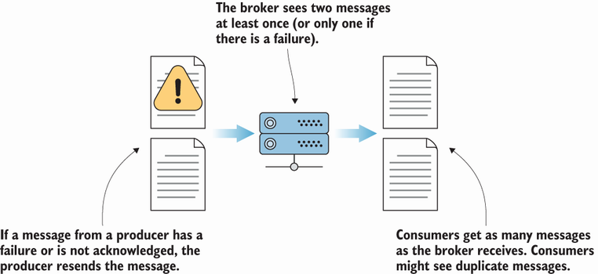
At-least-once message flow
Notes:
In this case, Kafka can be configured to allow a producer of messages to send the same message more than once and have it written to the brokers
For those cases where you can’t miss a message, say that someone has paid an invoice, this guarantee might take some filtering on the consumer end, but it is one of the safest delivery methods.

Slide 13
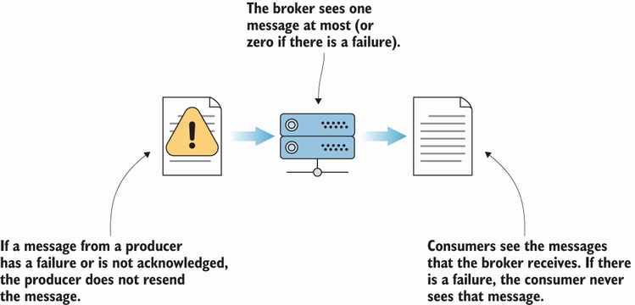
At-most-once message flow
Notes:
At-most-once semantics (figure 1.4) is when a producer of messages might send a message once and never retry. In the event of a failure, the producer moves on and doesn’t attempt to send it again
Why would someone be okay with losing a message? If a popular website is tracking page views for visitors, it might be okay with missing a few page view events out of the millions it processes each day. Keeping the system performing and not waiting on acknowledgments might outweigh any cost of lost data.

Slide 14
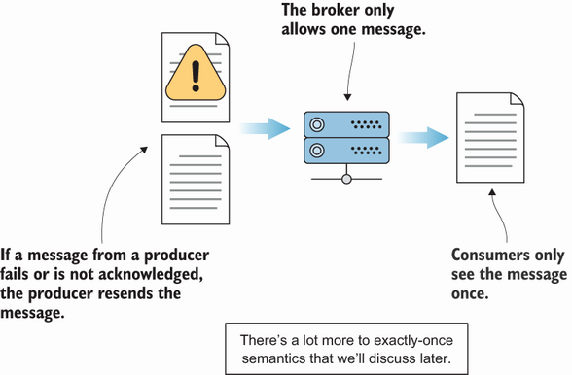
Exactly-once message flow
Notes:
Kafka added the exactly-once semantics, also known as EOS, to its feature set in version 0.11.0.
On the one hand, exactly-once semantics (figure 1.5) are ideal for a lot of use cases. This seemed like a logical guarantee for removing duplicate messages, making them a thing of the past.

Slide 15
Kafka usage
With many traditional companies facing the challenges of becoming more and more technical and software driven, one question is foremost: how will they be prepared for the future? One possible answer is Kafka
Kafka is noted for being a high-performance, message-delivery workhorse that features replication and fault tolerance as a default.
With Kafka, enormous data processing needs are handled with Kafka in production
Use Cases
Messaging: comparable to ActiveMQ or RabbitMQ
Website Activity Tracking
Metrics: Kafka is often used for operational monitoring data
Log Aggregation: Many people use Kafka as a replacement for a log aggregation solution
Stream Processing: Many users of Kafka process data in processing pipelines consisting of multiple stages
Event Sourcing: Event sourcing is a style of application design where state changes are logged as a time-ordered sequence of records
Commit Log
Notes:
Kafka can serve as a kind of external commit-log for a distributed system. The log helps replicate data between nodes and acts as a re-syncing mechanism for failed nodes to restore their data. The log compaction feature in Kafka helps support this usage. In this usage Kafka is similar to Apache BookKeeper project.

Slide 16
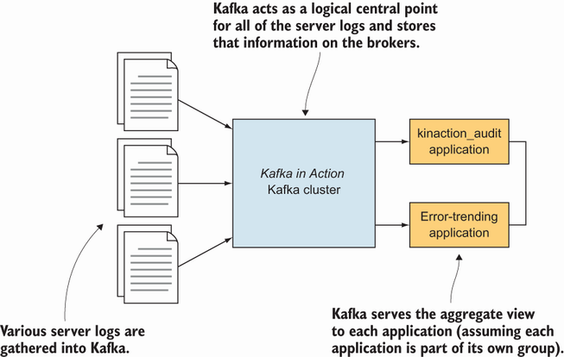

Slide 17
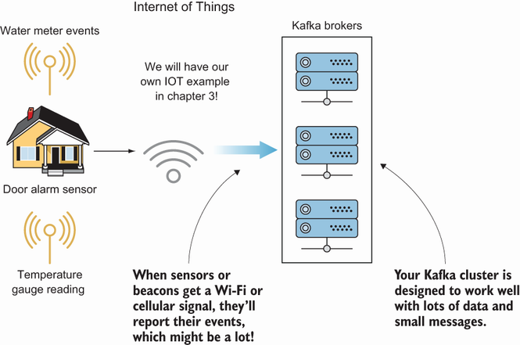

Slide 18
Summary
Apache Kafka is a streaming platform that you can leverage to process large numbers of events quickly.
Although Kafka can be used as a message bus, using it only as that ignores the capabilities that provide real-time data processing.
Kafka may have been associated with other big data solutions in the past, but Kafka stands on its own to provide a scalable and durable system. Because it uses the same fault tolerant and distributed system techniques, Kafka fills the needs of a modern data infrastructure’s core with its own clustering capabilities.
In instances of streaming a large number of events like IoT data, Kafka handles data fast. As more information is available for your applications, Kafka provides results quickly for your data that was once processed offline in batch mode.

Slide 19
02
Tour of Kafka

Slide 20
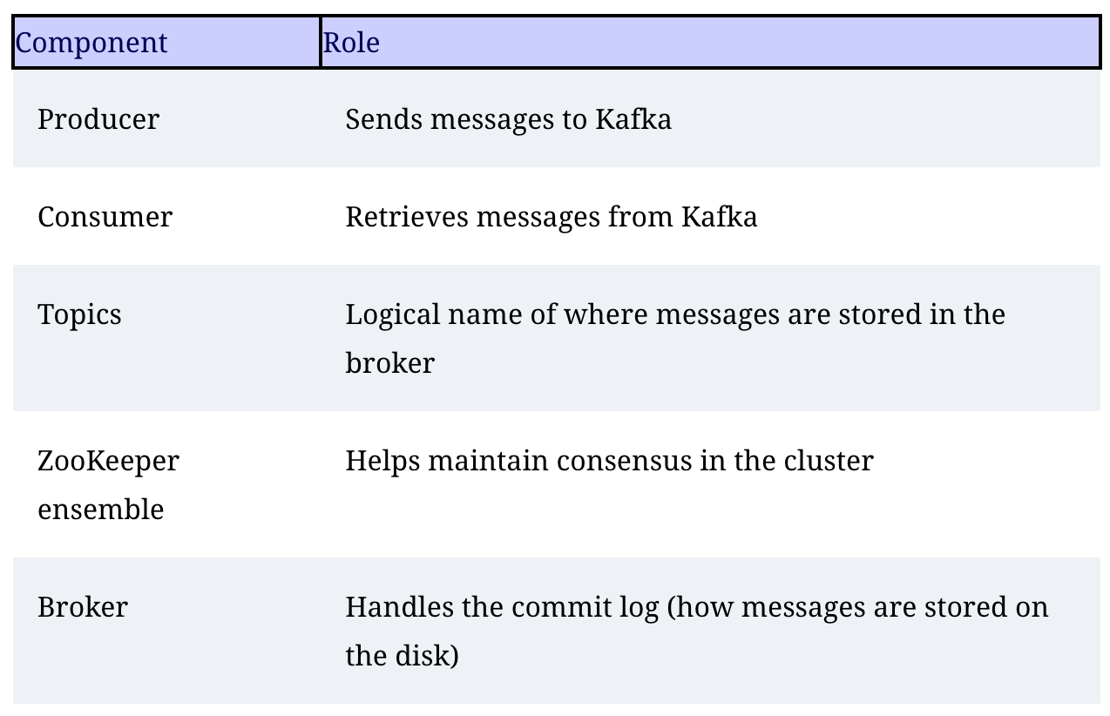
The Kafka architecture

Slide 21
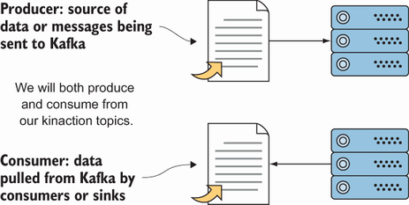
Producers and consumers
A producer is a tool for sending messages to Kafka topic
In contrast to a producer, a consumer is a tool for retrieving messages from Kafka
In the same vein as producers, if we are talking about getting data out of Kafka, we look at consumers as being involved directly or indirectly.

Slide 22
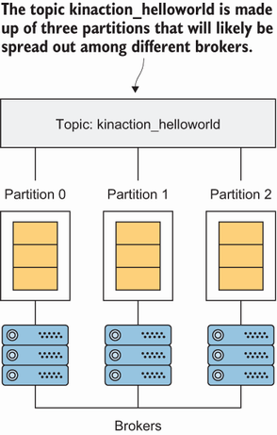
Topics overview
Topics are where most users start to think about the logic of what messages should go where.
Topics consist of units called partitions
In other words, one or more partitions can make up a single topic.

Slide 23
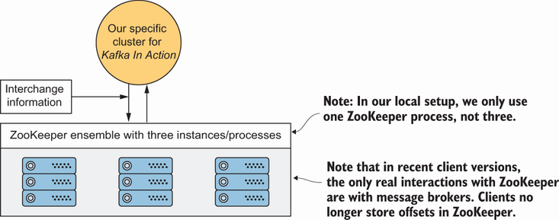
ZooKeeper usage
One of the oldest sources of feared added complexity in the Kafka ecosystem might be that it uses ZooKeeper
Apache ZooKeeper (http://zookeeper.apache.org/) is a distributed store that provides discovery, configuration, and synchronization services in a highly available way.

Slide 24
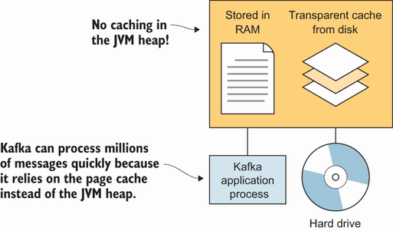
Kafka’s high-level architecture
In general, core Kafka can be thought of as Scala application processes that run on a Java virtual machine (JVM)
One of Kafka’s keys is its usage of the operating system’s page cache
By avoiding caching in the JVM heap, the brokers can help prevent some of the issues that large heaps may have

Slide 25
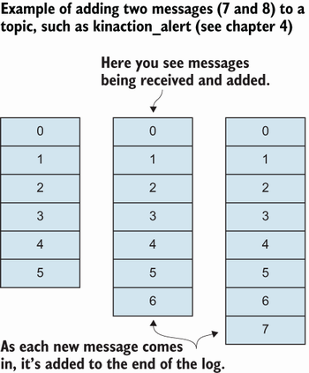
The commit log
One of the core concepts to help you master Kafka’s foundation is to understand the commit log.
The concept is simple but powerful.
What makes the commit log special is its append-only nature in which events are always added to the end.
The persistence as a log itself for storage is a major part of what separates Kafka from other message brokers.
Reading a message does not remove it from the system or exclude it from other consumers.

Slide 26
03
Apache Kafka QuickStart

Slide 27
Apache Kafka QuickStart
Step 1: Get Kafka
Download the latest Kafka release and extract it:
Step 2: Start The Kafka Environment
Note: Your local environment must have Java 8+ installed
Run the following commands in order to start all services in the correct order:
Open another terminal session ad run:
Once all services have successfully launched, you will have a basic Kafka environment running and ready to use.
tar -xzf kafka_2.13-3.2.0.tgz
cd kafka_2.13-3.2.0
# Start the ZooKeeper service
# Note: Soon, ZooKeeper will no longer be required by Apache Kafka.
$ bin/zookeeper-server-start.sh config/zookeeper.properties
# Start the Kafka broker service
$ bin/kafka-server-start.sh config/server.properties

Slide 28
Apache Kafka QuickStart (2)
Step 3: Create A Topic To Store Your Events
Kafka is a distributed event streaming platform that lets you read, write, store, and process events (also called records or messages in the documentation) across many machines.
Example events are payment transactions, geolocation updates from mobile phones, shipping orders, sensor measurements from IoT devices or medical equipment, and much more. These events are organized and stored in topics. Very simplified, a topic is similar to a folder in a filesystem, and the events are the files in that folder.
So before you can write your first events, you must create a topic. Open another terminal session and run:
Show details of the new topic
$ bin/kafka-topics.sh --create --topic quickstart-events --bootstrap-server localhost:9092
$ bin/kafka-topics.sh --describe --topic quickstart-events --bootstrap-server localhost:9092

Slide 29
Apache Kafka QuickStart (3)
Step 4: Write Some Events Into The Topic
A Kafka client communicates with the Kafka brokers via the network for writing (or reading) events
Once received, the brokers will store the events in a durable and fault-tolerant manner for as long as you need even forever.
Run the console producer client to write a few events into your topic. By default, each line you enter will result in a separate event being written to the topic.
You can stop the producer client with Ctrl+C at any time
$ bin/kafka-console-producer.sh --topic quickstart-events --bootstrap-server localhost:9092
This is my first event
This is my second event

Slide 30
Apache Kafka QuickStart (4)
Step 5: Read The Events
Open another terminal session and run the console consumer client to read the events you just created:
You can stop the producer client with Ctrl+C at any time
Feel free to experiment: for example, switch back to your producer terminal (previous step) to write additional events, and see how the events immediately show up in your consumer terminal.
Because events are durably stored in Kafka, they can be read as many times and by as many consumers as you want. You can easily verify this by opening yet another terminal session and re-running the previous command again.
$ bin/kafka-console-consumer.sh --topic quickstart-events --from-beginning --bootstrap-server localhost:9092
This is my first event
This is my second event

Slide 31
Apache Kafka QuickStart (5)
Step 6: Import/Export Your Data As Streams Of Events With Kafka Connect
You probably have lots of data in existing systems like relational databases or traditional messaging systems, along with many applications that already use these systems.
Kafka Connect allows you to continuously ingest data from external systems into Kafka, and vice versa.
It is an extensible tool that runs connectors, which implement the custom logic for interacting with an external system
Edit the config/connect-standalone.properties file, add or change the plugin.path configuration property match the following, and save the file:
Then, start by creating some seed data for test with:
Next, we'll start two connectors running in standalone mode, which means they run in a single, local, dedicated process. We provide three configuration files as parameters. The first is always the configuration for the Kafka Connect process, containing common configuration such as the Kafka brokers to connect to and the serialization format for data
> echo -e "foo\nbar" > test.txt
Notes:
First, make sure to add connect-file-3.2.0.jar to the plugin.path property in the Connect worker's configuration. For the purpose of this quickstart we'll use a relative path and consider the connectors' package as an uber jar, which works when the quickstart commands are run from the installation directory. However, it's worth noting that for production deployments using absolute paths is always preferable. See plugin.path for a detailed description of how to set this config.

Slide 32
Apache Kafka QuickStart (6)
> bin/connect-standalone.sh config/connect-standalone.properties config/connect-file-source.properties config/connect-file-sink.properties
These sample configuration files, included with Kafka, use the default local cluster configuration you started earlier and create two connectors:
The first is a source connector that reads lines from an input file and produces each to a Kafka topic
The second is a sink connector that reads messages from a Kafka topic and produces each as a line in an output file.
Once the Kafka Connect process has started, the source connector should start reading lines from test.txt and producing them to the topic connect-test, and the sink connector should start reading messages from the topic connect-test and write them to the file test.sink.txt
Note that the data is being stored in the Kafka topic connect-test, so we can also run a console consumer to see the data in the topic (or use custom consumer code to process it):
> bin/kafka-console-consumer.sh --bootstrap-server localhost:9092 --topic connect-test --from-beginning
Notes:
During startup you'll see a number of log messages, including some indicating that the connectors are being instantiated. Once the Kafka Connect process has started, the source connector should start reading lines from test.txt and producing them to the topic connect-test, and the sink connector should start reading messages from the topic connect-test and write them to the file test.sink.txt. We can verify the data has been delivered through the entire pipeline by examining the contents of the output file:

Slide 33
Apache Kafka QuickStart (7)
Step 7: Process Your Events With Kafka Streams
Once your data is stored in Kafka as events, you can process the data with the Kafka Streams client library for Java/Scala
It allows you to implement mission-critical real-time applications and microservices, where the input and/or output data is stored in Kafka topics
View more documents: https://kafka.apache.org/documentation/streams/
Npm: https://www.npmjs.com/package/kafka-streams

Slide 34
Apache Kafka QuickStart (8)
Step 8: Terminate The Kafka Environment
Now that you reached the end of the quickstart, feel free to tear down the Kafka environment—or continue playing around.
Stop the producer and consumer clients with Ctrl-C, if you haven't done so already.
Stop the Kafka broker with Ctrl-C.
Lastly, stop the ZooKeeper server with Ctrl-C.
If you also want to delete any data of your local Kafka environment including any events you have created along the way, run the command:
$ rm -rf /tmp/kafka-logs /tmp/zookeeper

Slide 35
04
NodeJS & Kafka

Slide 36
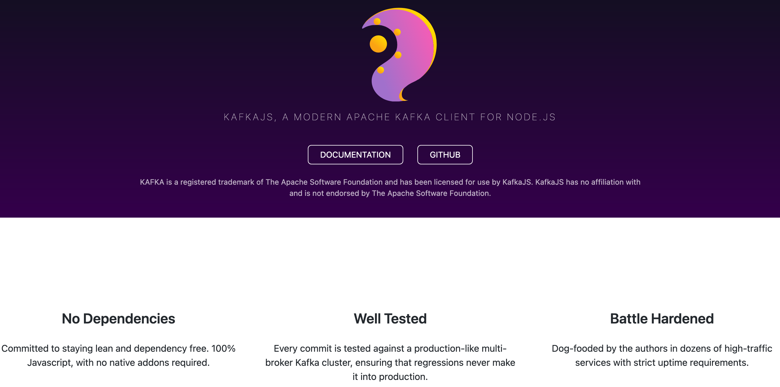

Slide 37
A Brief Intro to Kafka
Glossary
Term | Description
Cluster | The collective group of machines that Kafka is running on
Broker | A single Kafka instance
Topic | Topics are used to organize data. You always read and write to and from a particular topic
Partition | Data in a topic is spread across a number of partitions. Each partition can be thought of as a log file, ordered by time. To guarantee that you read messages in the correct order, only one member of a consumer group can read from a particular partition at a time.
Producer | A client that writes data to one or more Kafka topics
Consumer | A client that reads data from one or more Kafka topics
Replica | Partitions are typically replicated to one or more brokers to avoid data loss.

Slide 38
A Brief Intro to Kafka (2)
Term | Description
Leader | Although a partition may be replicated to one or more brokers, a single broker is elected the leader for that partition, and is the only one who is allowed to write or read to/from that partition
Consumer group | A collective group of consumer instances, identified by a groupId. In a horizontally scaled application, each instance would be a consumer and together they would act as a consumer group.
Group Coordinator | An instance in the consumer group that is responsible for assigning partitions to consume from to the consumers in the group
Offset | A certain point in the partition log. When a consumer has consumed a message, it "commits" that offset, meaning that it tells the broker that the consumer group has consumed that message. If the consumer group is restarted, it will restart from the highest committed offset.
Rebalance | When a consumer has joined or left a consumer group (such as during booting or shutdown), the group has to "rebalance", meaning that a group coordinator has to be chosen and partitions need to be assigned to the members of the consumer group.
Heartbeat | The mechanism by which the cluster knows which consumers are alive. Every now and then (heartbeatInterval), each consumer has to send a heartbeat request to the cluster leader. If one fails to do so for a certain period (sessionTimeout), it is considered dead and will be removed from the consumer group, triggering a rebalance.

Slide 39
Message Formats
Although we commonly refer to the data in topics as "messages", there is no uniform shape that messages take.
From Kafka's perspective, a message is just a key-value pair, where both key and value are just sequences of bytes.
It is up to the data producer and the consumers to agree on a format.
Commonly you will find plain-text schemaless messages in for example JSON, or binary formats with an enforced schema such as AVRO.

Slide 40
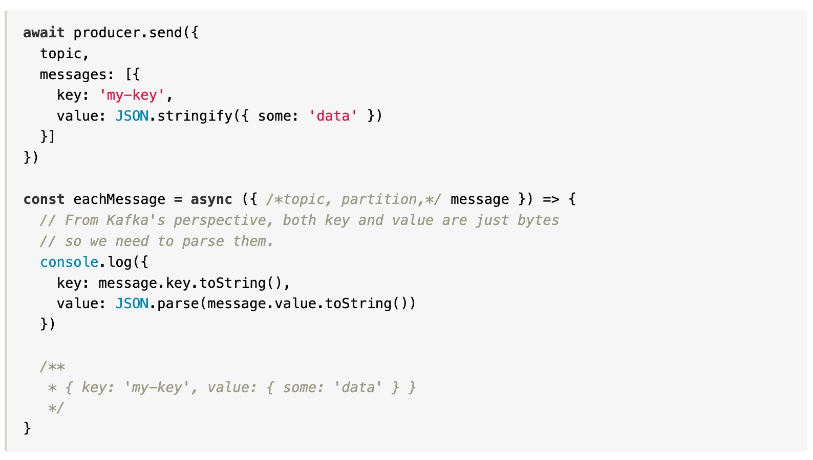
Message Formats: Plain-Text JSON
JSON needs no introduction. It's simple and easy to work with.
The only thing we need to do is turn the message Buffer into a string and parse it.
The downside of using JSON is that it does not enforce any kind of schema, so after you have parsed the message, you have no way of knowing what fields are available and what types they have.
Notes:
The downside of using JSON is that it does not enforce any kind of schema, so after you have parsed the message, you have no way of knowing what fields are available and what types they have. The data producer makes no guarantees that fields will be present or that their types won't change, making it challenging and error-prone to work with.

Slide 41
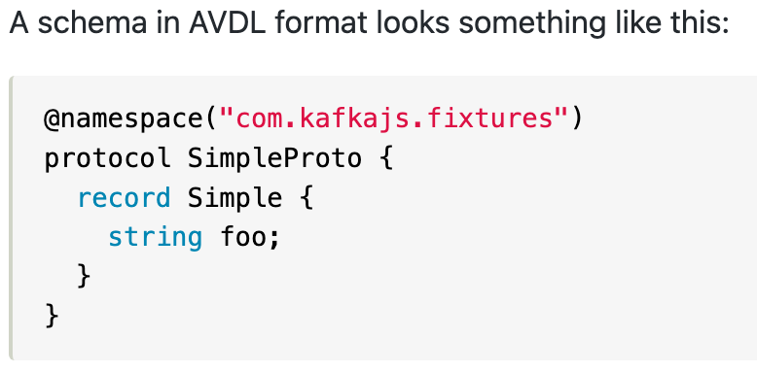
Message Formats: AVRO
AVRO is a data serialization system that turns your messages into a compact binary format according to a defined schema.
This allows the consumer to know exactly what each message contains, and the producer to be aware when they are making potentially breaking changes to the schema.
In order to encode or decode a message, the producer or consumer needs to have access to the correct schema.
https://www.npmjs.com/package/@kafkajs/confluent-schema-registry
Notes:
The downside of using JSON is that it does not enforce any kind of schema, so after you have parsed the message, you have no way of knowing what fields are available and what types they have. The data producer makes no guarantees that fields will be present or that their types won't change, making it challenging and error-prone to work with.

Slide 42
Getting Started
Install KafkaJS using npm
Let's start by instantiating the KafkaJS client by pointing it towards at least one broker:
Now to produce a message to a topic, we'll create a producer using our client:
npm i kafkajs -d
const { Kafka } = require('kafkajs’);
const kafka = new Kafka({
clientId: 'kafka-fund',
brokers: ['localhost:9092'],
});
const producer = kafka.producer();
await producer.connect();
await producer.send({
topic: 'test-topic',
messages: [ { value: 'Hello KafkaJS user!' }, ],
});
await producer.disconnect();

Slide 43
Getting Started (2)
Finally, to verify that our message has indeed been produced to the topic, let's create a consumer to consume our message:
const consumer = kafka.consumer({ groupId: 'test-group’ });
await consumer.connect();
await consumer.subscribe({ topic: 'test-topic', fromBeginning: true });
await consumer.run({
eachMessage: async ({ topic, partition, message }) => {
console.log({
value: message.value.toString(),
})
},
});

Slide 44
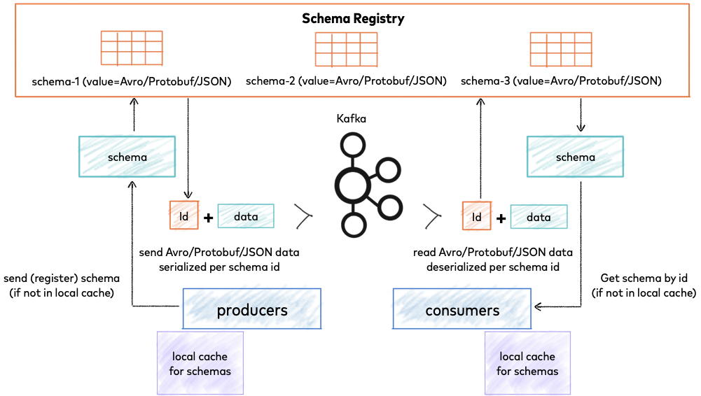

Slide 45
Confluent Schema Registry
confluent-schema-registry is a library that makes it easier to interact with the Confluent schema registry, it provides convenient methods to encode, decode and register new schemas using the Apache Avro, JSON Schema and Protobuf serialization formats and Confluent's wire format.
Install: npm install @kafkajs/confluent-schema-registry
const path = require('path');
const { SchemaRegistry, SchemaType } = require('@kafkajs/confluent-schema-registry');
const registry = new SchemaRegistry({ host: 'http://localhost:8081' });
// Upload a schema to the registry
const schema = ` { "type": "record", "name": "RandomTest", "namespace": "examples", "fields": [{ "type": "string", "name": "fullName" }] } ` ;
const { id } = await registry.register({ type: SchemaType.AVRO, schema });
// Encode using the uploaded schema
const payload = { fullName: 'John Doe' };
const encodedPayload = await registry.encode(id, payload);
// Decode the payload
const decodedPayload = await registry.decode(encodedPayload);

Slide 46
Usage
Typical usage consists of uploading one or more schemas to the registry, encoding data using the registered schemas, and/or decoding encoded data by getting the schemas from the registry.
Creating the registry client
Uploading schemas
The schemas can be registered with the schema registry using registry.register({ type: SchemaType, schema: string }), which resolves to an object containing the schema id. This schema id is later used when encoding.
const { SchemaRegistry } = require('@kafkajs/confluent-schema-registry')
const registry = new SchemaRegistry({ host: 'http://localhost:8081' })
const schema = {
type: SchemaType.AVRO | SchemaType.JSON | SchemaType.PROTOBUF,
schema: "string" }
const options = { subject: "string" }
await registry.register(schema, options)

Slide 47
Usage (2)
Uploading schemas
Avro (https://avro.apache.org/docs/current/index.html)
To simplify working with Avro schemas and integrating with existing tooling, some utility functions are available
Schemas can be defined in either AVSC or AVDL format, and are read using readAVSCAsync and avdlToAVSCAsync respectively.
const schema = `
{
"type": "record",
"name": "RandomTest",
"namespace": "examples",
"fields": [{ "type": "string", "name": "fullName" }]
}
`
const { id } = await registry.register({ type: SchemaType.AVRO, schema })
const { SchemaType, readAVSCAsync, avdlToAVSCAsync } = require('@kafkajs/confluent-schema-registry')
// From an avsc file
const schema = await readAVSCAsync('path/to/schema.avsc')
const { id } = await registry.register({ type: SchemaType.AVRO, schema }) // { id: 2 }
// From an avdl file
const schema = await avdlToAVSCAsync('path/to/protocol.avdl’)
const { id } = await registry.register({ type: SchemaType.AVRO, schema }) // { id: 3 }

Slide 48
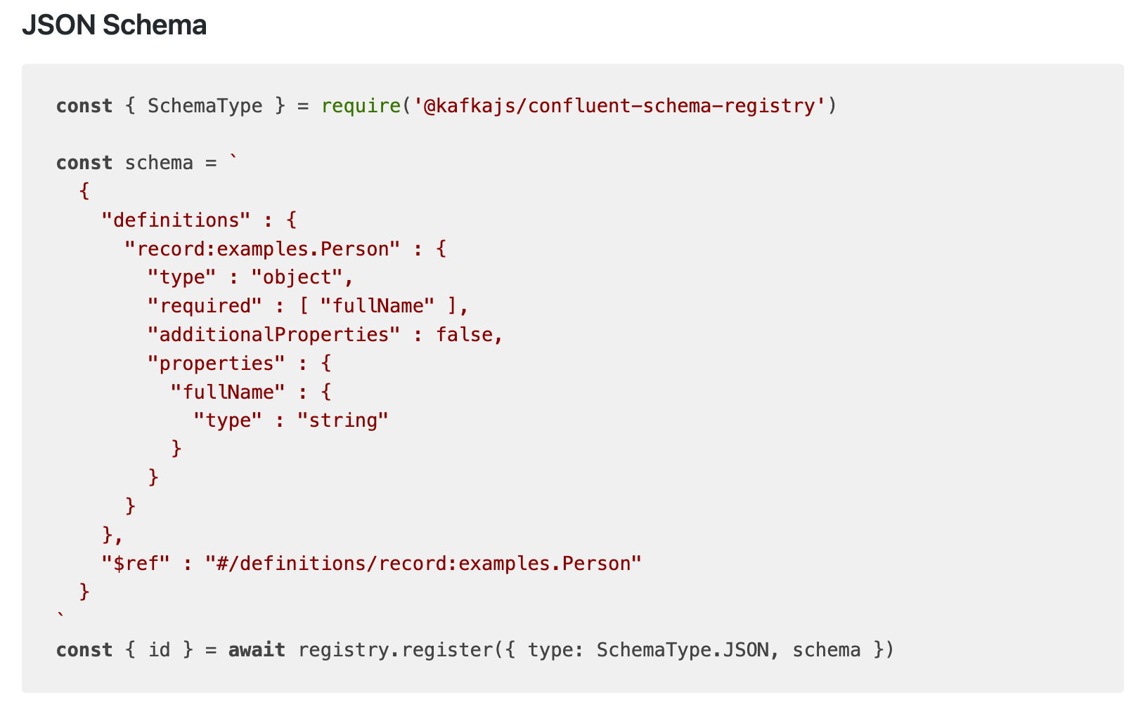
Usage (3)

Slide 49
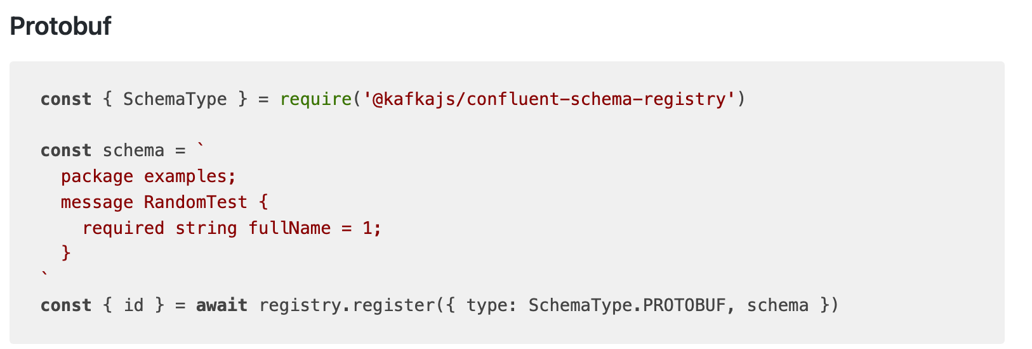
Usage (3)

Slide 50
Confluent Schema Registry configuration
Install Docker
docker run -d \
--name=schema-registry \
-e SCHEMA_REGISTRY_KAFKASTORE_BOOTSTRAP_SERVERS=VuiLenDis-MBP:9092 \
-e SCHEMA_REGISTRY_HOST_NAME=docker-desktop \
-e SCHEMA_REGISTRY_DEBUG=true \
-p 8081:8081 \
confluentinc/cp-schema-registry:7.1.1

